Slide 1
Chapter 14 Java Platform
FALL 2021

Slide 2
Java Introduction
Designed by a team at Sun in 1990-1991
It is a merging of C and Object-Oriented Programming concepts
All of the basic instructions are C (loops, branches, functions, variables and types)
Java is a pure object-oriented programming language; C++, merely added OOP concepts onto existing C
Designers of Java only kept those features of C that helped them making Java a simpler language
Java supports distributed operation and platform independence, one of the primary needs of internet-based programming

Slide 3
Portability - Definition
Portability refers to the ability to run a program on different machines
Running a given program on different machines can require different amounts of work (for example, no work whatsoever, recompiling, or making small changes to source code)
When people refer to applications as portable, they usually mean the applications run on different types of machines with no changes (such as recompilation or tweaks to the source code).

Slide 4
Portability
A piece of software is portable if it can be used on many different types of computers
Object code is not very portable. As you know, object code is comprised of binary-format instructions.
Here’s an example of an object-code instruction: 0100001111101010
Those binary-format instructions are intimately tied to a particular type of processor. If you’ve got object code that was created on a type X computer, then the object code can run only on a type X computer.

Slide 5
Java Portability
Java provides three distinct types of portability:
Source code portability
CPU architecture portability, and
OS/GUI portability

Slide 6
Source code portability in Java
Although the syntax of C and C++ is well defined, the semantics are not.
This semantic looseness allows a single block of C or C++ sources code to compile to programs that give different results when run on different CPUs, operating systems, compilers, and even on a single compiler/CPU/OS combination, depending on various compiler settings.

Slide 7
Source code portability in Java
Java defines more behavior (semantics) than C and C++.
In Java, memory does not get freed until it can no longer be accessed, and
The language does not have any uninitialized variables
All these features help to narrow the variation in the behavior of a Java program from platform to platform and implementation to implementation

Slide 8
Java CPU portability
Most compilers produce object code that runs on one family of CPU (for example, the Intel x86 family).
The current Java compilers are different. Instead of producing output for each different CPU family on which the Java program is intended to run, the current Java compilers produce object code (called J-code) for a CPU that does not yet exist.
Java is architecture-neutral. A compiled Java program’s bytecode instructions target a generic virtual machine instead of a specific platform. Because each platform-specific virtual machine implementation supplies a consistent interface to the bytecodes, the same Java program runs on diverse platforms (via their virtual machines).

Slide 9
Compiler vs. Interpreter
A compiler is a program that translates a source program written in some high-level programming language into machine code for some computer architecture (such as the Intel Pentium architecture). The generated machine code can be later executed many times against different data each time.
An interpreter reads each line of the source code and converts it to machine code on the fly. This happens every time the program in run. Consequently, it is very slow as it is converting source code to machine code while the program is running. A compiler does it once and that’s it.
The tradeoff is the speed. An interpreter is generally slower than a compiler because it processes and interprets each statement in a program as many times as the number of the evaluations of this statement. For example, when a for-loop is interpreted, the statements inside the for-loop body will be analyzed and evaluated on every loop step.

Slide 10
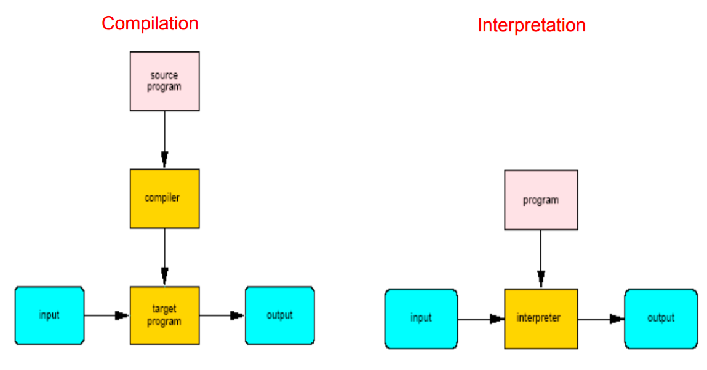
Compilation and Interpretation

Slide 11
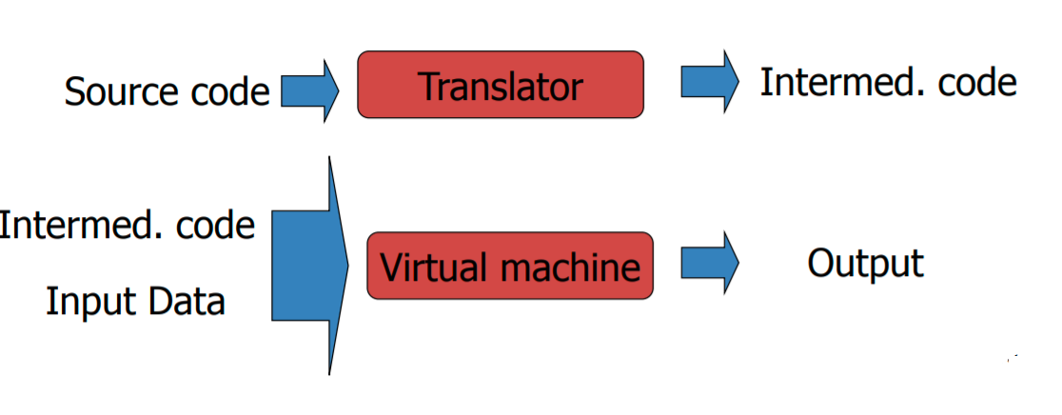
Java is both Compiled and Interpreted
Java is compiled and interpreted:
Java’s compiler translates source code into class files of bytecode instructions.
A virtual machine (interpreter) examines each instruction and uses that instruction’s meaning to execute an equivalent sequence of platform-dependent instructions..

Slide 12
Bytecode
For most languages, compilation produces machine code
Java compilation produces bytecode
Intermediate code readable by the virtual machine
Portable across the different platform

Slide 13
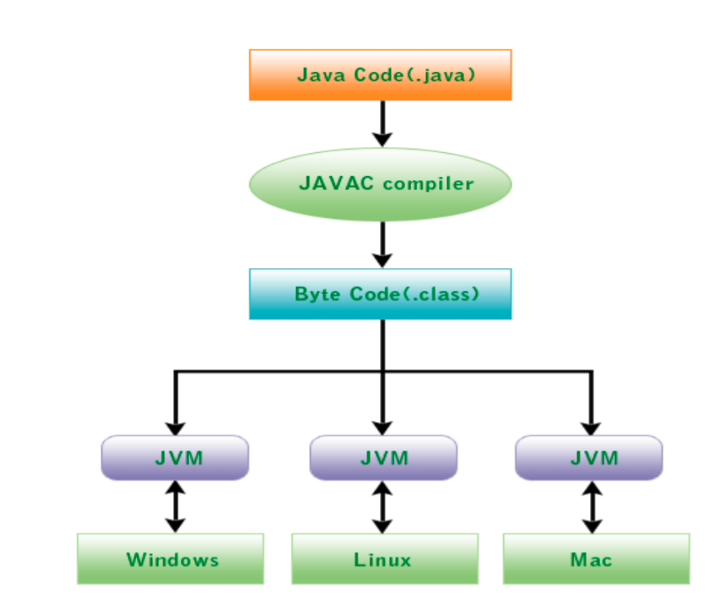
Java is both compiled and interpreted

Slide 14
Java OS and GUI portability
After eliminating the semantic problems in C and C++ and the CPU porting problems, programmers still must deal with the different operating system and different GUI API calls.
Just like JVM presents a virtual CPU, the Java libraries present a virtual OS/GUI. Every Java implementation provides libraries implementing the virtual OS/GUI. Java programs that use these libraries to provide needed OS and GUI functionality port fairly easily: swing.

Slide 15
awt vs. swing
AWT (Abstract windows toolkit):
Native heavyweight components
AWT components are platform dependent
AWT is a thin layer of bytecode on top of the OS
Package is under java
Swing
Portable or lightweight
Swing components are made in purely Java, and they are platform independent
Swing bytecode is much larger
Swing has richer functionality
Package is under javax

Slide 16
Why Swing belongs to the javax packages
Originally, everything that was part of the standard API was part of the java package.
Everything that was not part of the standard API was released under the package name javax.
In javax, the “x” stands for extension.
Over time the extensions that were released as javax, become integral to the Java API.
However, moving the extension from the javax package to the java package would be too cumbersome and would end up breaking a bunch of existing code.
Hence, eventually it was decided that the javax packages would become part of the standard API.

Slide 17
Downside of Java Portability
Unfortunately, the features that make Java so portable have a downside. Java assumes a:
32-bit machine with 8-bit bytes and
IEEE754 floating-point math
Machines that do not fit this model, like 8-bit microcontrollers cannot run Java efficiently
For this reason, we should expect C and C++ to be used on more platforms than the Java language. We also should expect Java programs to port easier than C or C++ between those platforms that do support both.

Slide 18
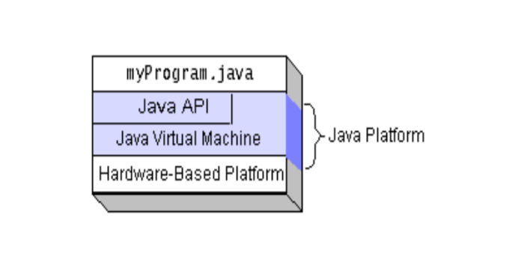
Java Platform
The Java Virtual Machine JVM
The Java Application Programming Interface (API)

Slide 19
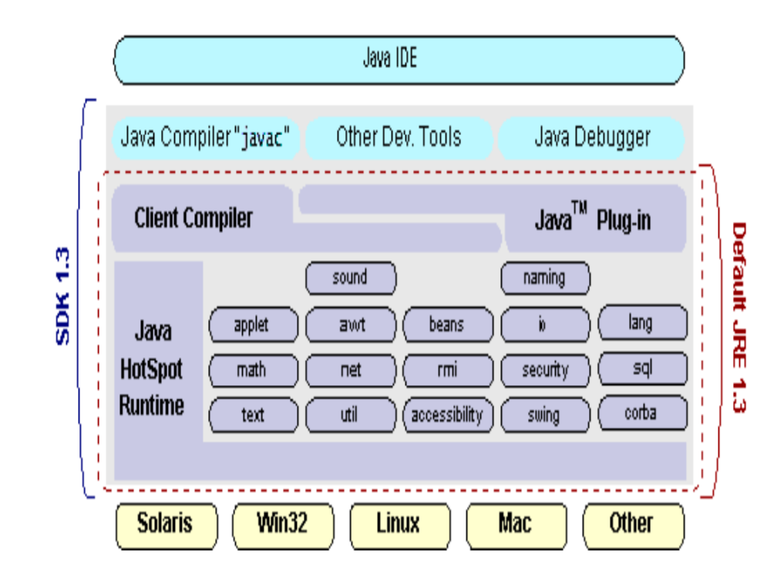
Production vs. Runtime Environment

Slide 20
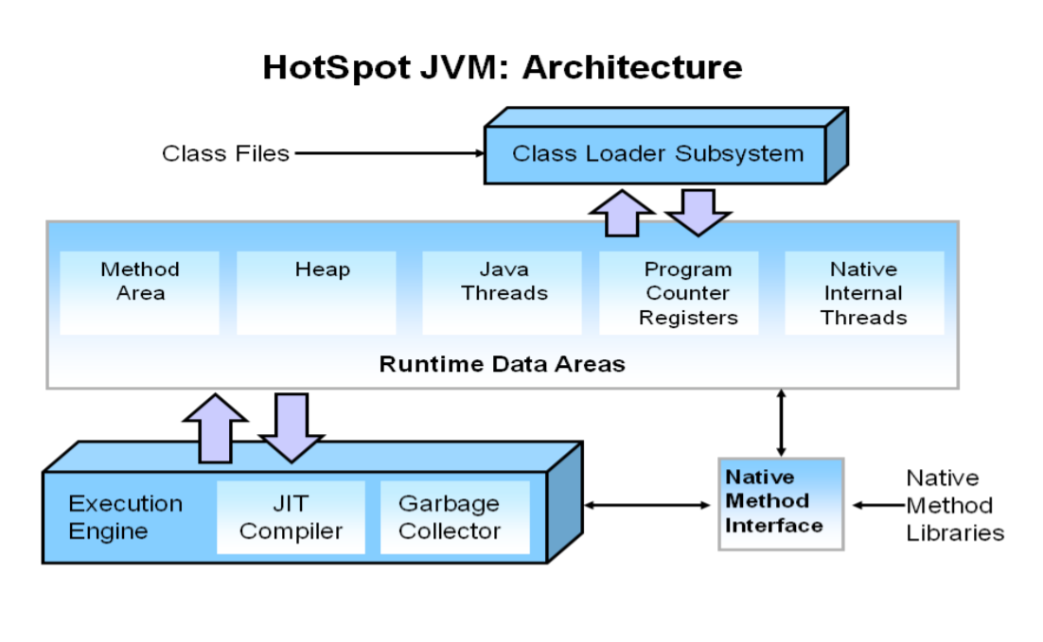
The Java Virtual Machine

Slide 21
Java Performance
Java performance is sometimes criticized, execution of bytecode is never as fast as it would be with compiled code.
There are many ways to improve performance:
Just-in-time-compilation: a JIT compiles bytecode into native machine code, stored the native code, and reinvokes it when its bytecode is executed.
Java HotSpot Performance Engine: includes a compiler for optimizing the most frequently used code.

